Slide 1





LaunchUp #20 Supporters
Special thanks to LaunchUp Service Providers:

Slide 2

Amp Session:
Phil Windley
Founder & CTO, Kynetx

Slide 3

LaunchUp #20 Supporters
Special thanks to LaunchUp Service Providers:

Slide 4

In The Weeds:
A Masochist's Guide to Managing Scope
Tyler Bye
Managing Partner, Protoven

Slide 5
A Masochist’s guide to
Managing Scope

Slide 6

Could you help us integrate?
-
Just a simple request...

Slide 7
Customer Punch List
Reporting extensions and additions to analytics
Support for unique player ID requiring new player release
Development of UGC website
Numerous hours of research into regional key ruleset bypassing techniques
Integration with additional GEO IP provider
Special internal broadcast player env
Rush Key Server Release
Custom development of player pages
Ad break searches and marking
Custom extensions to CMS
Major design, development and overhaul of regional DRM ruleset
Development of custom CMS derivative
Custom development for ad support
…

Slide 8


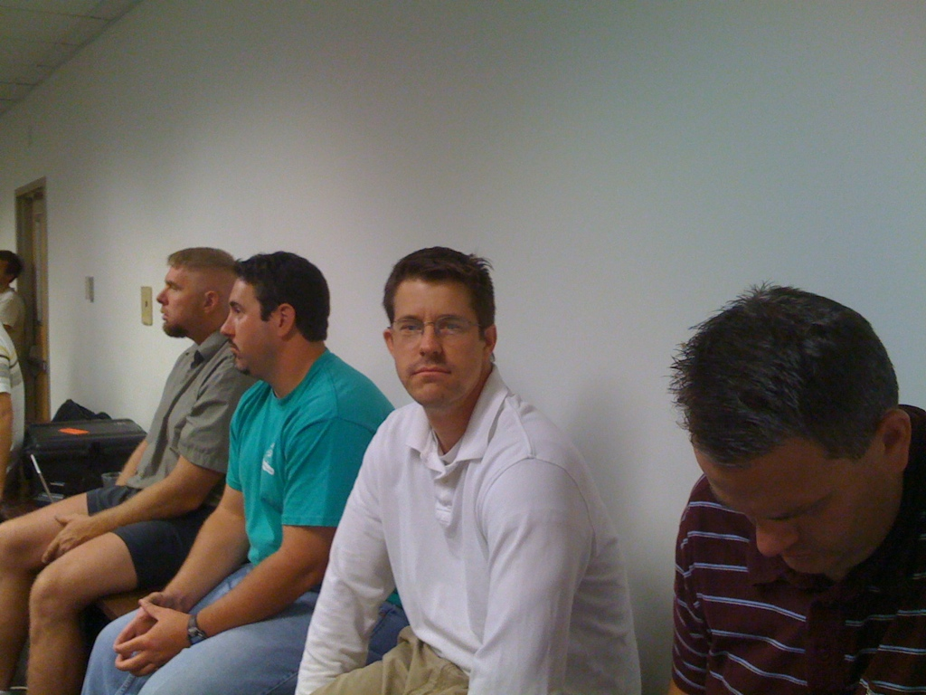
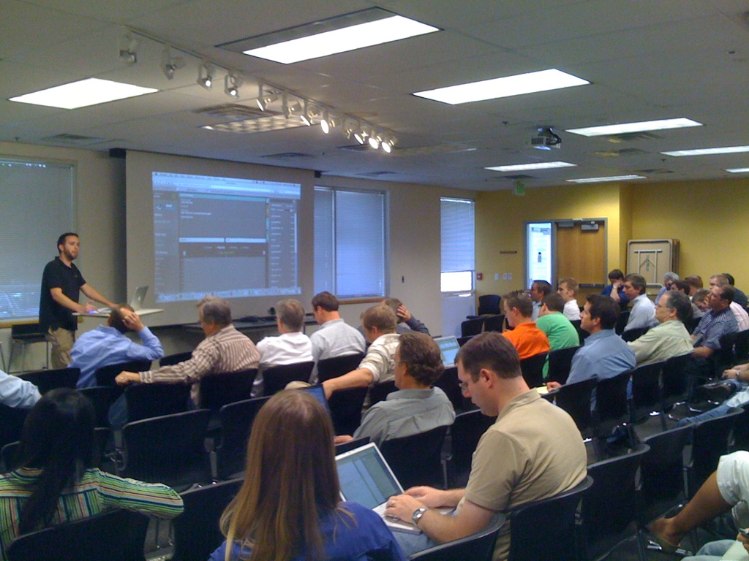
Throwing People
... becomes the problem
Customer demands/expects more
Roadmap slips
Innovation stops
No resources for new opportunities

Slide 9

Changes can be good

Slide 10

Consider 20% of requests From...
Customers that represent 80% of Revenue
&
If 80% of all customers can reuse
Bye’s 80 / 20 Rule of
Scope Creep

Slide 11

“ We are not announcing any new products at this time.”
-

Slide 12

Release
Early & Often
A Core Set of Features
A Product that feels finished
operations

Slide 13
Provide
Documentation
Development Kits, Tools and Examples
A Quick-start
operations

Slide 14
Ideal Early Customer
Knowledgeable of the domain
Injured by your competitor(s)
Provides great feedback
Pays their bills
operations

Slide 15


Thanks!
Tyler Bye
tbye@tbye.com
@tbye

Slide 16
LaunchUp #20 Supporters
Special thanks to LaunchUp Service Providers:

Slide 17

Leading the way for online therapy

Slide 18


Slide 19

The Solution

Slide 20
Client
Provider

Slide 21
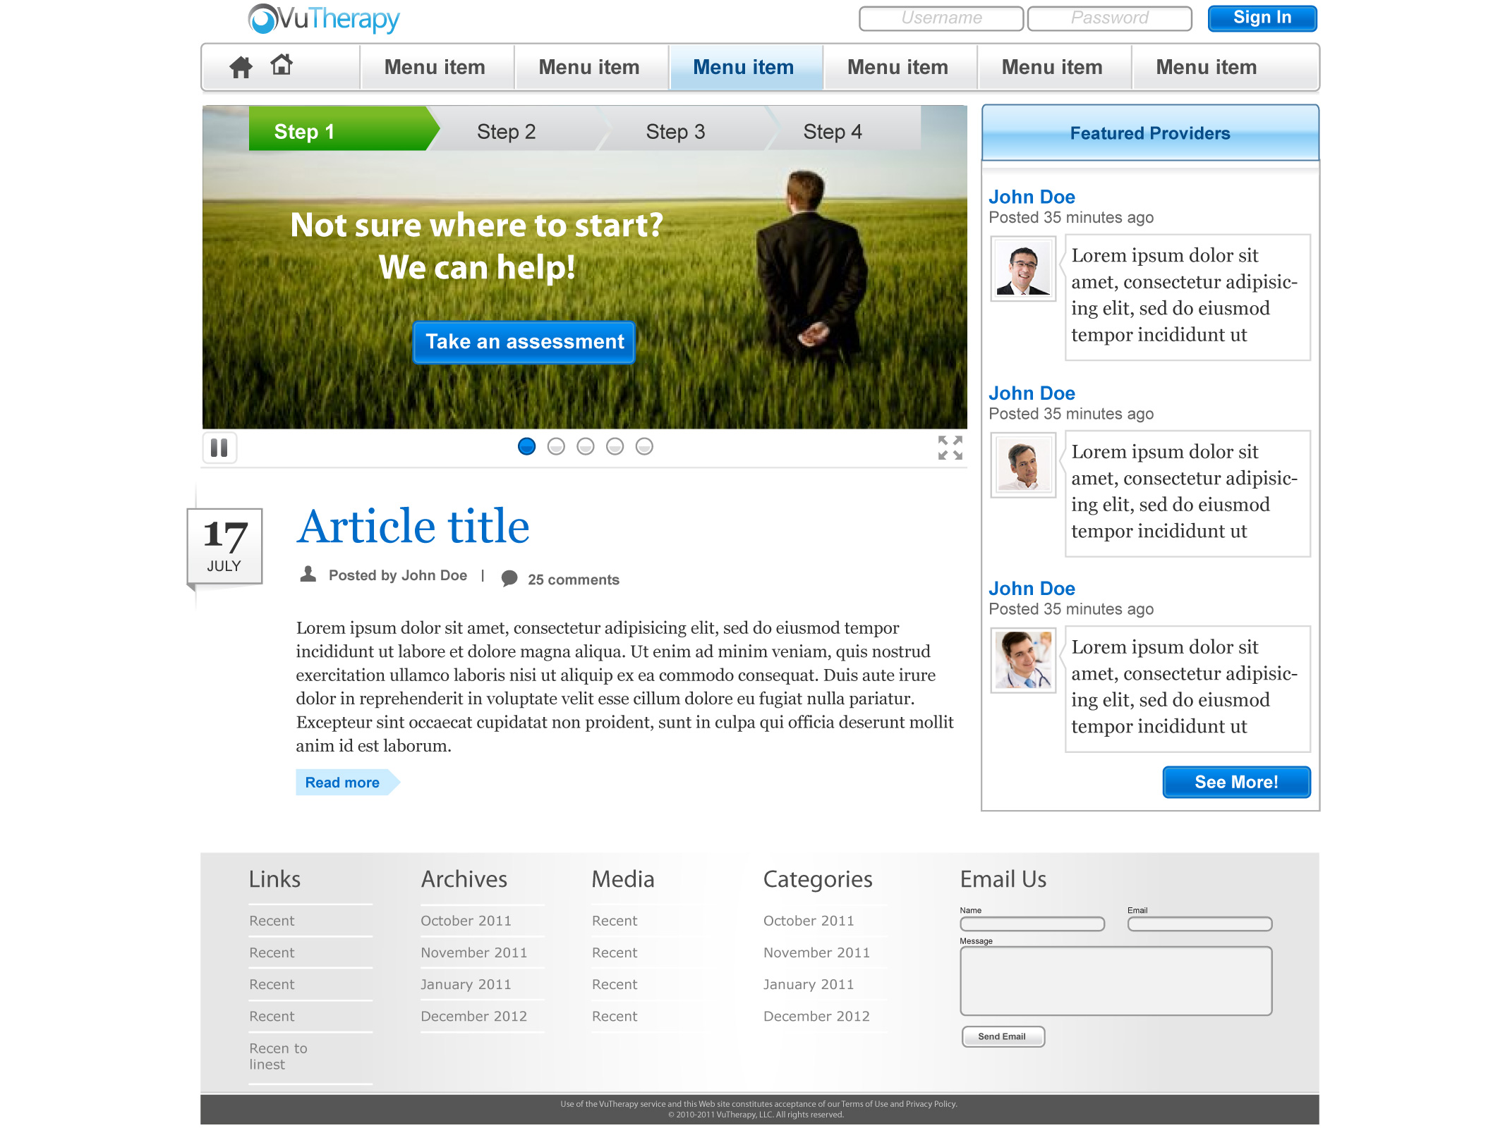

Slide 22
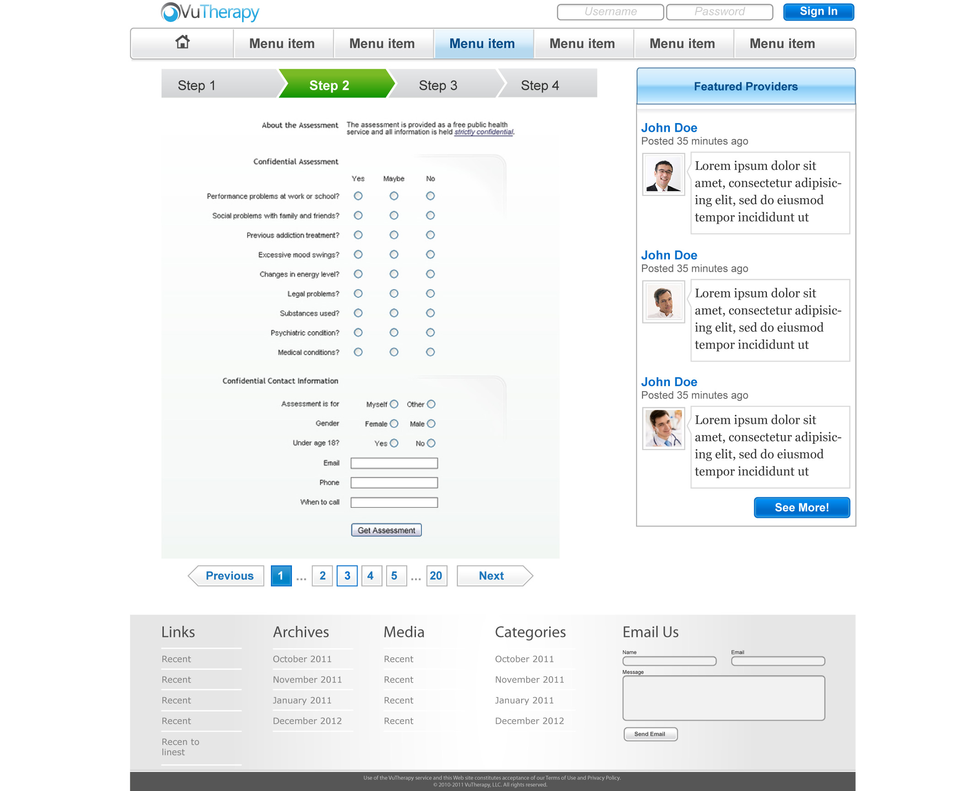

Slide 23
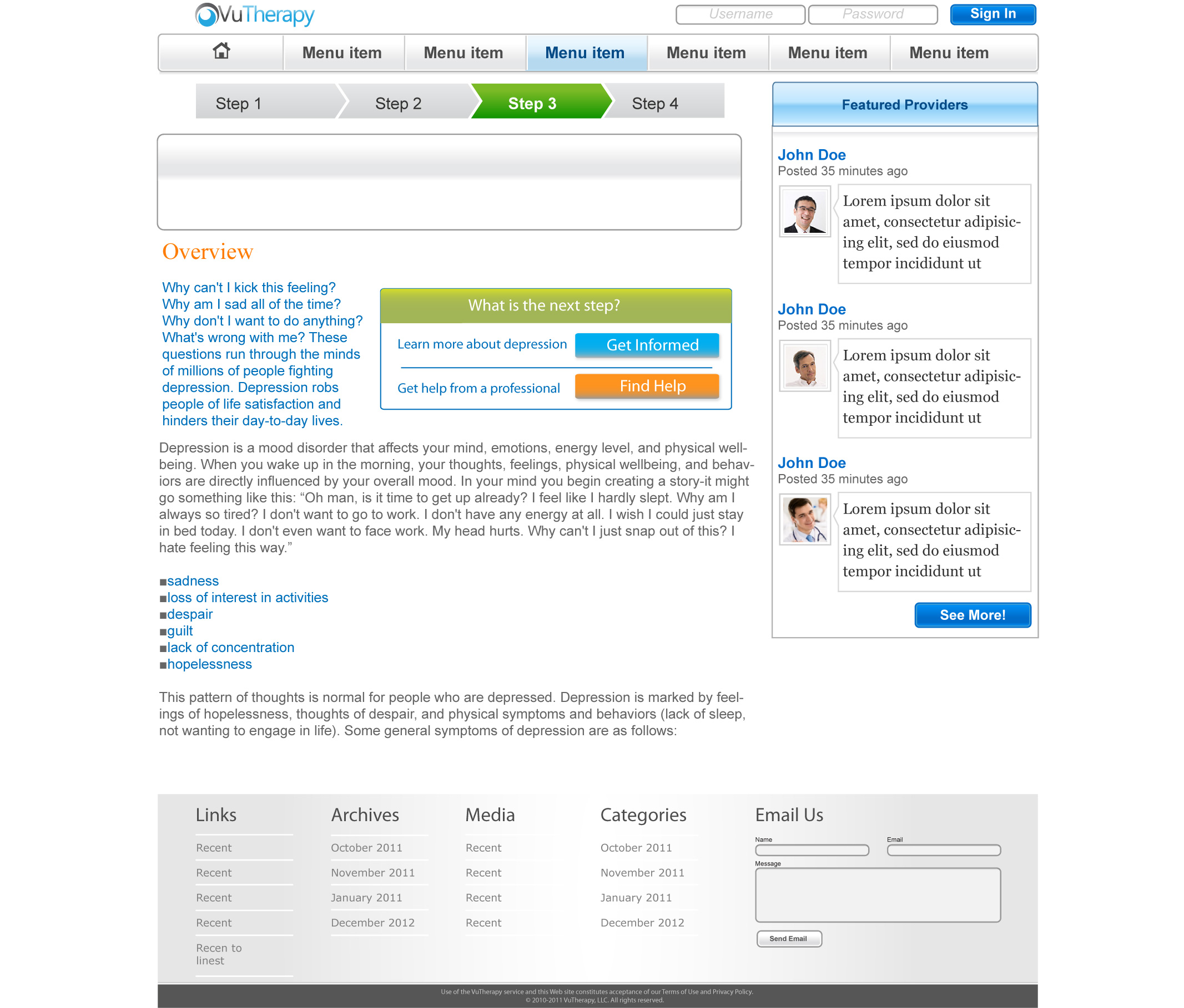

Slide 24


Slide 25
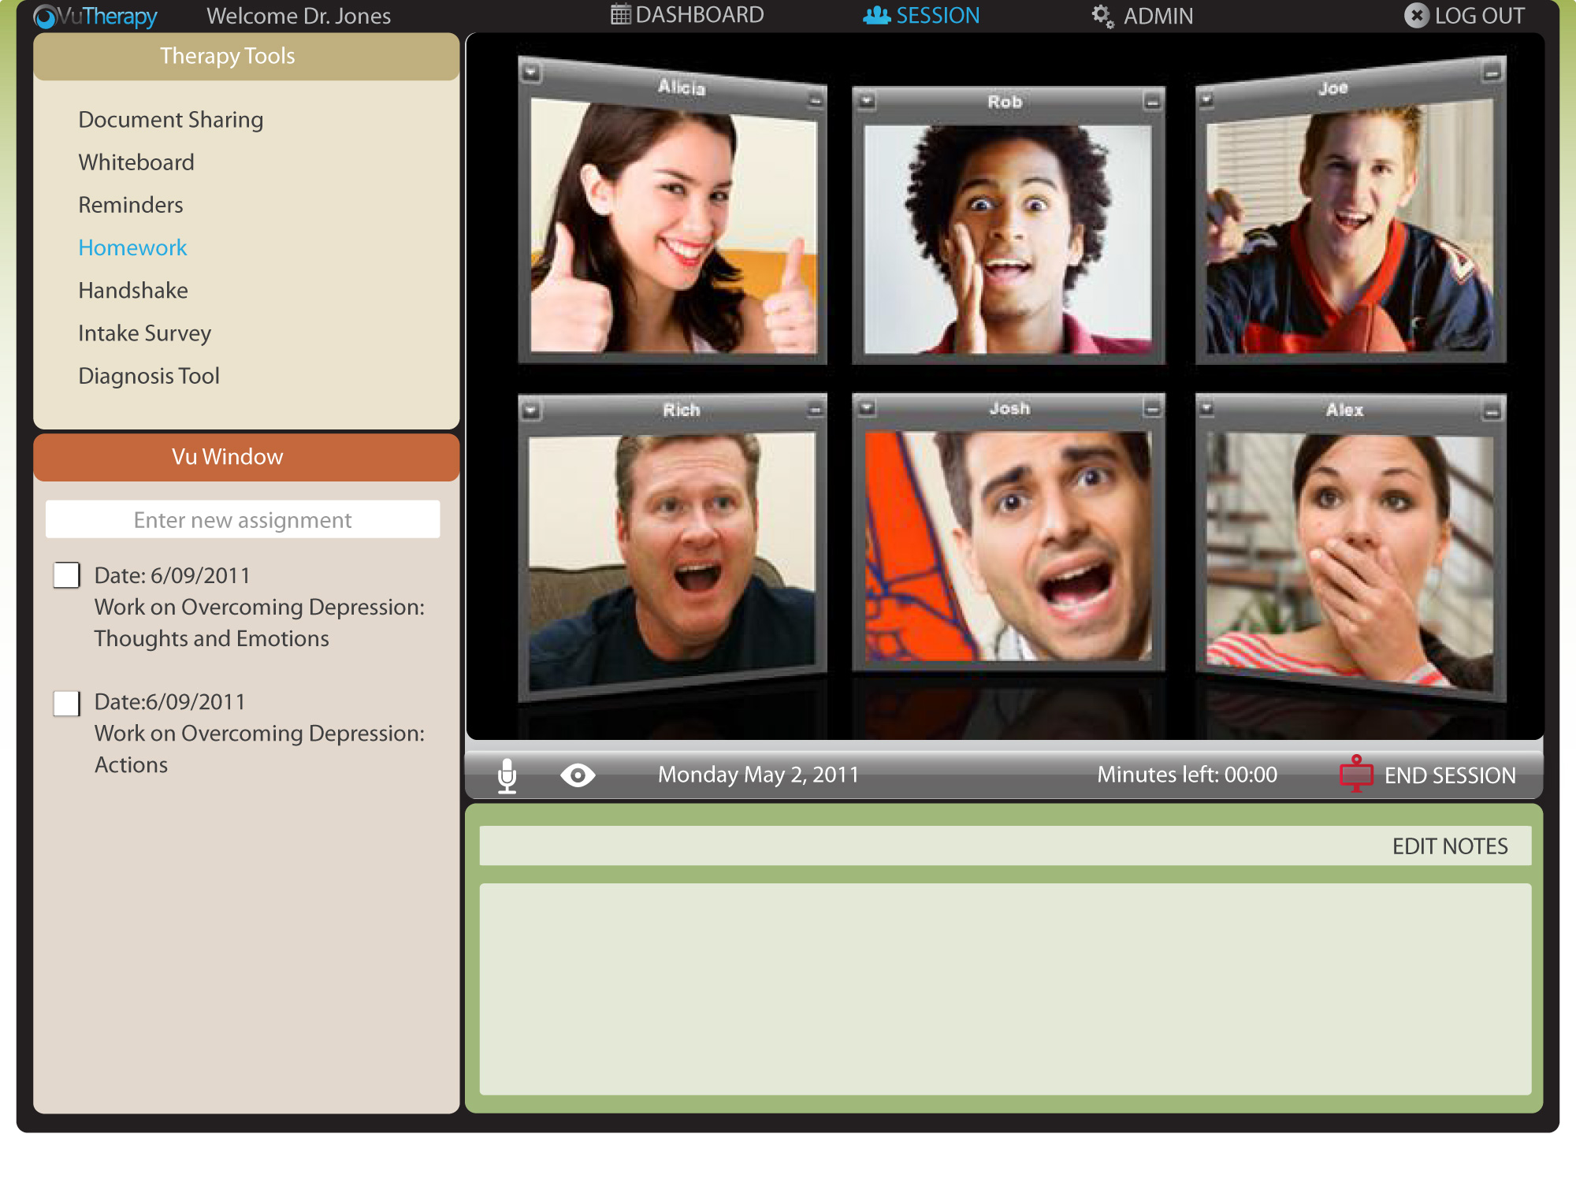

Slide 26
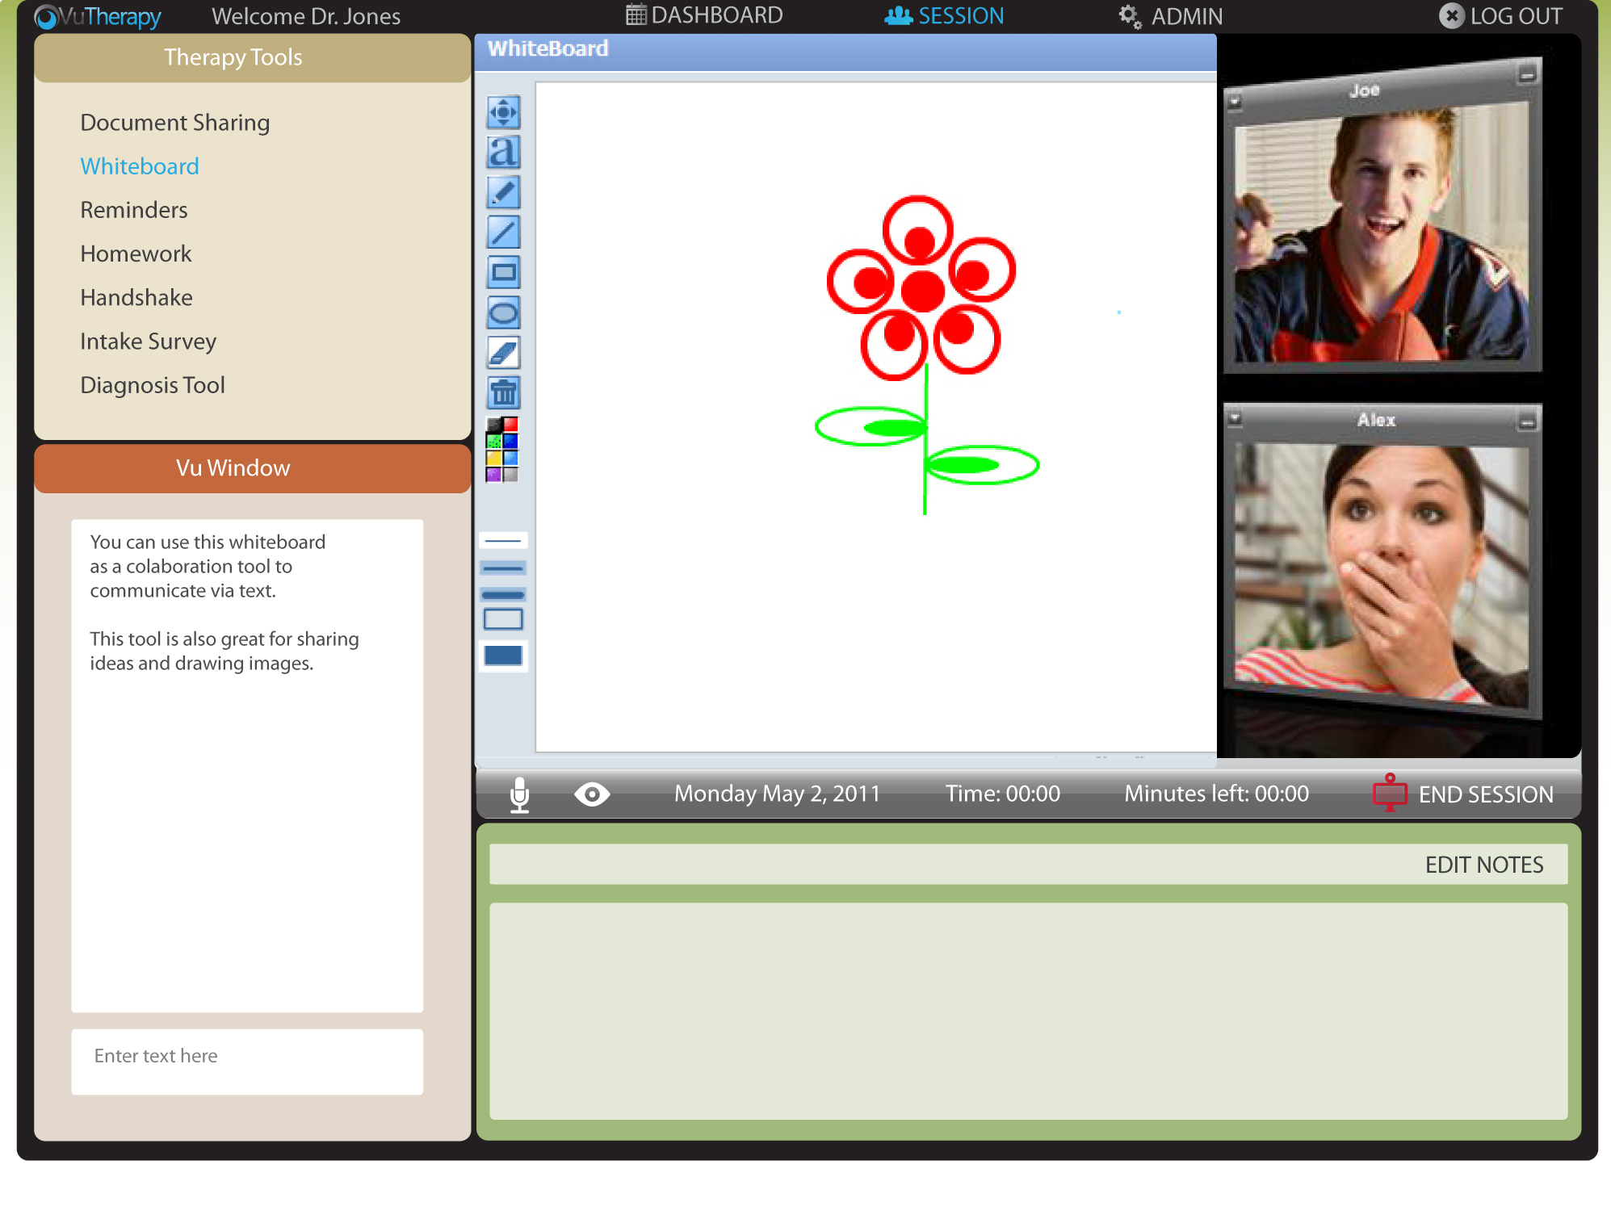

Slide 27


Slide 28


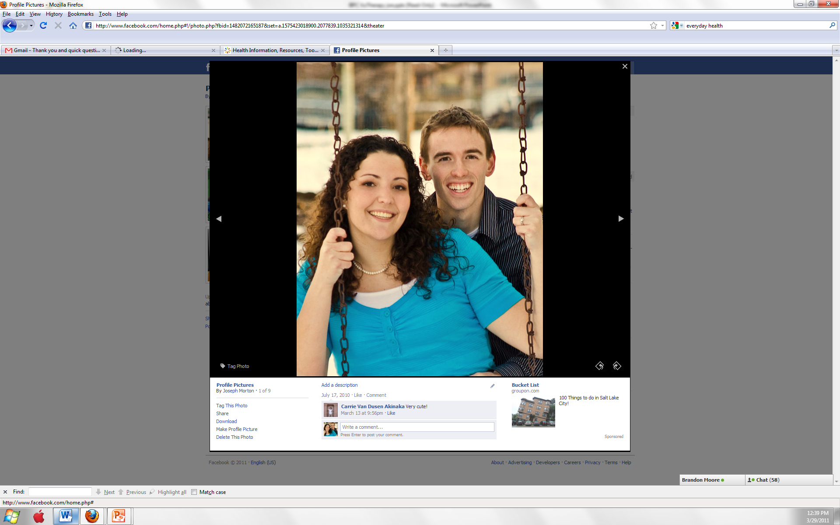

Russ Petersen
Programmer
Liz Petersen
Chief Technology Officer
JOSEPH MORTON
Chief Operations Officer
BRIGHAM ARCE
Chief Executive Officer

Slide 30
Client
Provider

Slide 31

We need your help!
Who do you know that is in mental ealth?

Slide 32
LaunchUp #20 Supporters
Special thanks to LaunchUp Service Providers:

Slide 33

fueling your lifestyle

Slide 34














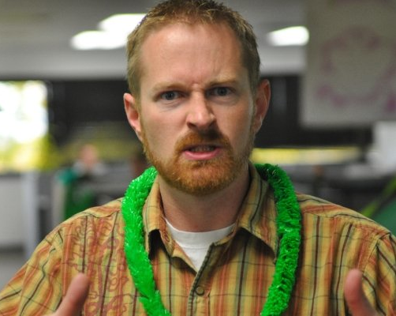
Problem
-Too many sites to shop
-Too many emails
-Irrelevant deals
-Miss deals he wants
-Impulse buy and buyer’s remorse

Slide 35

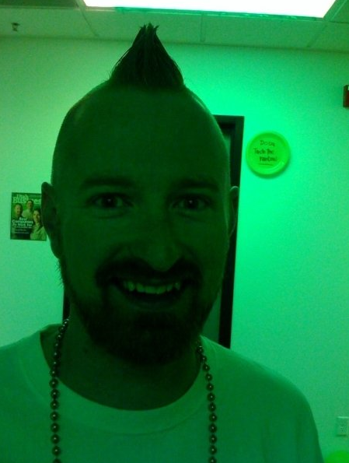
Solution
Rocks!!
Preferences!

Slide 36


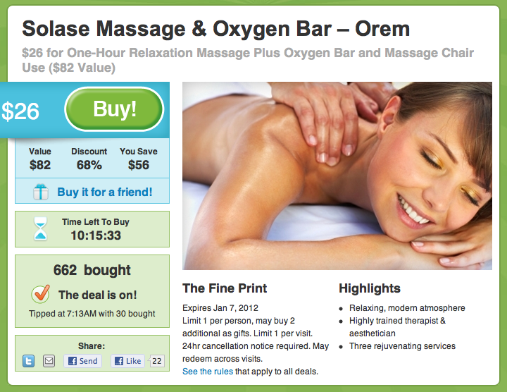
Solution
marketplace
How do we make sure you don’t buy a used deal?

Slide 37
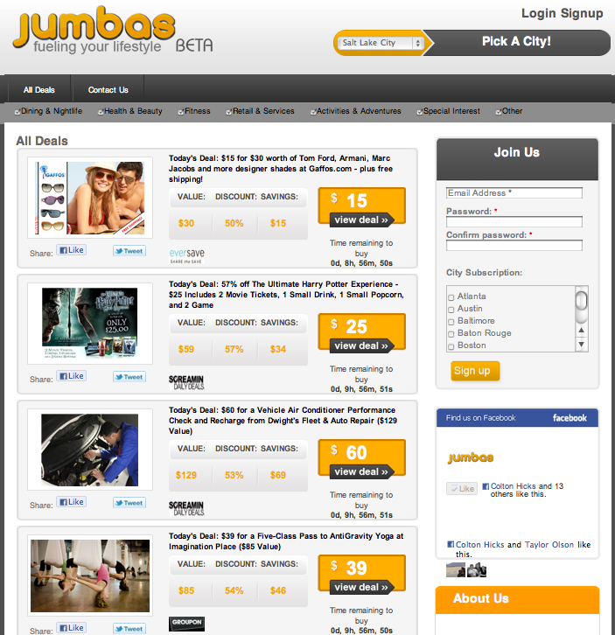
Screen Shots

Slide 38













Revenue
Affiliate Commissions!
Marketplace

Slide 39
Challenges & Help Needed!
Getting Users
Creating engagement around company FB page

Slide 40
LaunchUp #20 Supporters
Special thanks to LaunchUp Service Providers:

Slide 41


Seth Shoultes
Garth Koyle
Event Espresso, LLC. Copyright 2011

Slide 42
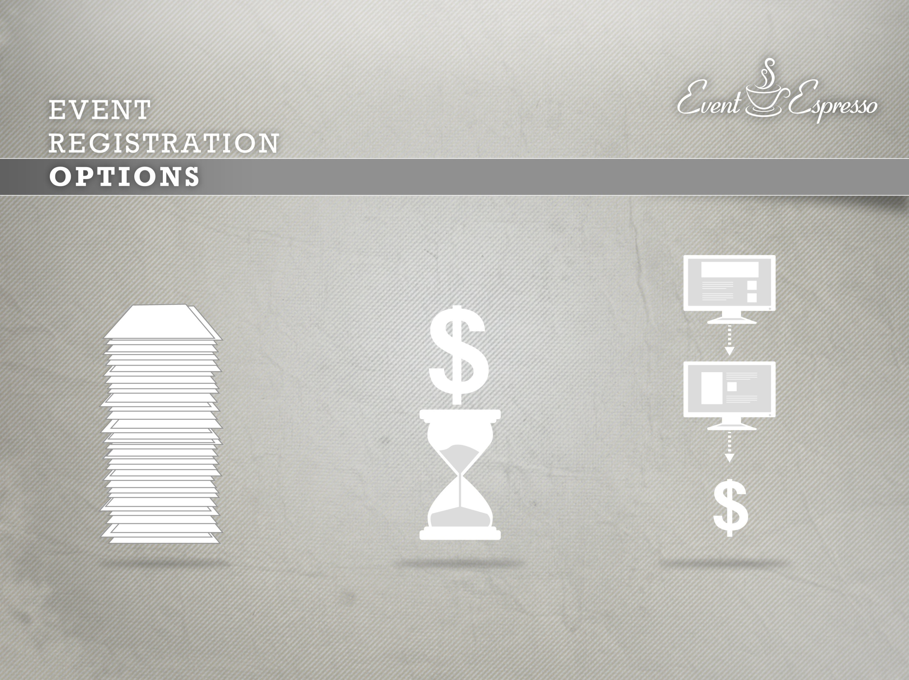
Manual
Registration
Custom Built
System
Third-Party
Service
Notes:
If you host events (conference/class imagery) and you need to get registrations and payment from attendees, what options do you have?
Option #4: You can tell people to email you and send you a check… (imagery: lots of paperwork)
Option #3: You can have a programmer build you a system (imagery: clock and expensive)
Option #2: You can use a third-party website to accept registrations for you (imagery: expensive, separate website)
Or

Slide 43

WordPress Content Management System (Free)
Event Registration
Attendee Management
$89.95
Savings
Many Features
Unlimited Use
Customizable
Notes:
Option #1: If you have a website built on the WordPress (WP Badge) content management system, within minutes (timer dings) you can have event registration (image of form), payment (image of cash), attendee management capabilities (image of person), and more. Event Espresso (show logo) gives you all this - a $200,000 software for as little as $59.95.
This is a monumental shift away from expensive and third-party providers to independence.
Over 1400 event managers and webmasters use Event Espresso every day to make their events more successful.

Slide 44

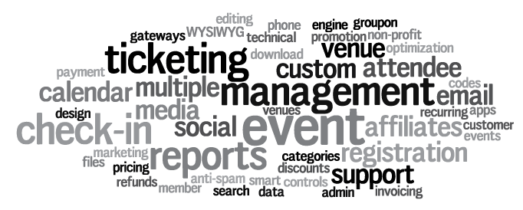
MARKET NEEDS
EVENT
REGISTRATION
Affordability
Unlimited Use for < $100
Autonomy
Ownership and Scalability
Features
Event Espresso, LLC. Copyright 2011

Slide 45
EVENT
REGISTRATION
EVENT ESPRESSO TODAY (PLUGIN)
Paying Customers: 1,400; ~20% repurchase
March Revenue: $23,000; 15% growth in March
March Net Profit*: $17,000; 74% margin
Potential Market (Annually):
  ~ 37k Event plugin users, increasing by ~ 23k
  ~ $3.6M total in 2011
Event Espresso, LLC. Copyright 2011

Slide 46
EVENT
REGISTRATION
EVENT ESPRESSO STRATEGY (HOSTED)
What about the 210 Million non-WordPress users or people without a website?
Hosted Solution
  Customers use our Event Espresso website
  Easy setup, 40% less expensive than industry leaders
  Scalable sales chain: Hosted customer > premium hosted customer > plugin customer
  Transaction risk upon Gateways, not users
Market Size: $350M+/yr
Event Espresso, LLC. Copyright 2011

Slide 47
EVENT
REGISTRATION
MARKET GROWTH DRIVERS & MARKETING
Plugin
(WordPress Users)
WordPress Adoption ~ 30k daily, Free
Small Business Event Growth
Need for feature-rich, affordable, scalable
Hosted Solution
(Non-WordPress Users)
Market Leaders Doubled Rev. in 2010
Small Business Event Growth
Turn-key services
Targeted Marketing
Search Engine Optimization
Search Engine Advertising
WordCamp/Event Industry Sponsorship
Email Marketing
Customer Advocacy (Social Media)
Feature Development/Up-selling
Media Partnerships/Releases
Non-Profit Discounts
Direct sales
Event Espresso, LLC. Copyright 2011

Slide 48
EVENT
REGISTRATION
COMPETITORS
 | Strength | Weaknesses | Fees for 100 Ticket Sales
Eventbrite | Mature product, resources (investors), brand equity. Dominant market share, growth. | Poor product for WordPress (WP) integration; no additional website capabilities; no premium products; more expensive. | $250+
Cvent | Mature product, resources, brand equity. Diverse set of products. | No product for WordPress (WP) integration; more expensive; higher administrative costs; less brand equity than Eventbrite.com. | $1,700+
RegOnline | Mature product, resources, brand equity. | No product for WordPress (WP) integration; no additional website capabilities; expensive; higher administrative costs; less brand equity than Eventbrite.com and cvent.com. | $450+
There are currently no other premium event registration plugins available for sale.
Event Espresso, LLC. Copyright 2011

Slide 49
EVENT
REGISTRATION
BARRIERS TO ENTRY
Event Espresso has lower costs
Licensing - GPL & Private
Equivalent development cost ~ $200,000
Event Espresso, LLC. Copyright 2011

Slide 50
EVENT
REGISTRATION
EVENT ESPRESSO REVIEW
Industry disruption
Meets needs: affordability, autonomy, features
Marketing plan reaches the target audience
Financial discipline and reinvestment
Event Espresso, LLC. Copyright 2011

Slide 51
EVENT
REGISTRATION
THANK YOU
Questions?
Event Espresso, LLC. Copyright 2011

Slide 52
EVENT
REGISTRATION
TESTIMONIALS
“I’m so excited to fire Eventbrite! @EventEspresso has an amazing WP plugin for event mngmt. We’re testing it now & are very impressed! In a nutshell Event Espresso saves us money & does everything Eventbrite did b4. ” ~ Dustin Nay
“Customizing an Event Registration plugin for WordPress by @EventEspresso. Love the pro version. Highly Recommended!” ~ Joshua Garity
“I searched long and hard to find something that would serve my needs. This is, by far, the most complete and comprehensive solution I have found.” ~ Bill Hepper
“Absolutely the best, both in product and service!!! Two thumbs up!” ~ Salene
“Event Espresso is so easy to use yet feature rich and stable. It is a cornerstone of our site and our success.” ~ fbarnes
“Have you seen the WordPress event plugin from @eventespresso? It’s crazy how much you can do with it.” ~ JR Farr
Event Espresso, LLC. Copyright 2011

Slide 53
LaunchUp #20 Supporters
Special thanks to LaunchUp Service Providers:

Slide 54
Announcements

Slide 55
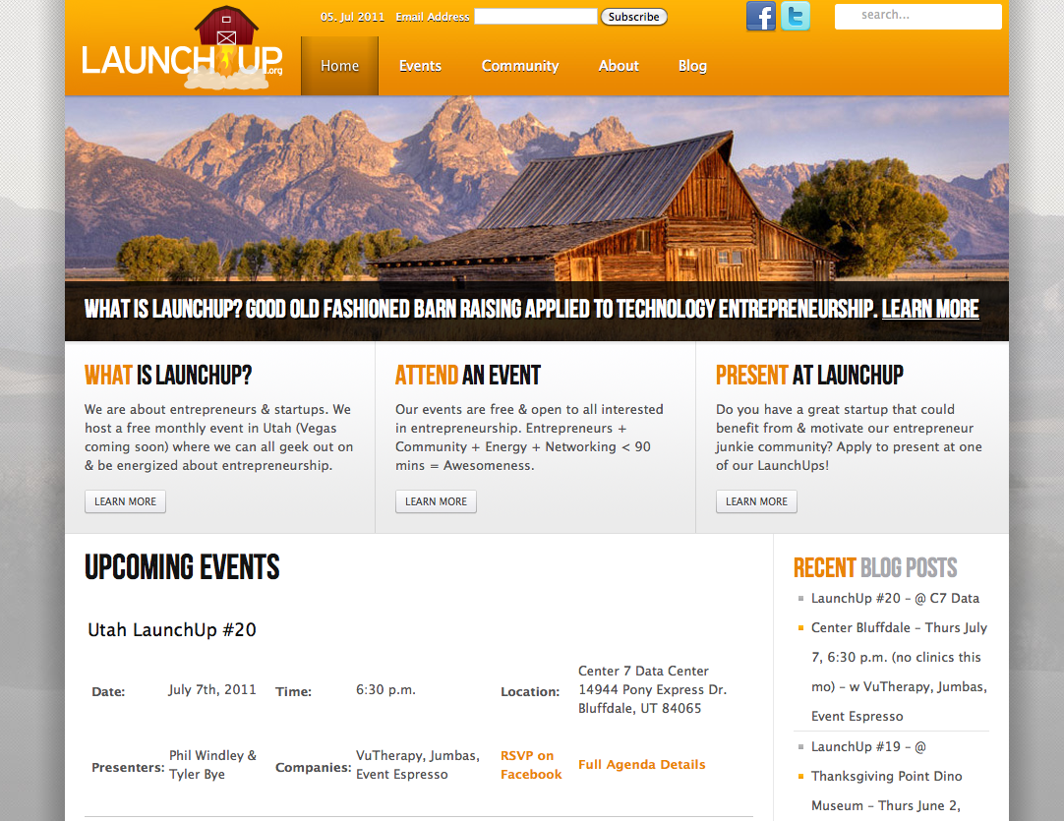

Slide 56
Doba is lonely, LaunchUp Wants Sponsors!

Slide 57












Social Commerce Exchange
When: August 11, 2011 5:30 PM – 9:00 PM
Where: Salt Lake Community College –Miller Campus
For Registration Information:
Email - info@whitehallventures.com

Slide 58


Slide 60
LaunchUp #21
Thursday July 7, 2011 6:30 p.m.
(No Clinics, will resume in Sept)
Location: TBD
First Thursday = LaunchUp somewhere

Slide 61
LaunchUp #20 Supporters
Special thanks to LaunchUp Service Providers:

