Slide 1






LaunchUp #13 Supporters
Special thanks to LaunchUp Service Providers:

Slide 2







Friends of LaunchUp
http://www.launchup.org/friends

Slide 3

LaunchUp #13 Supporters
Special thanks to LaunchUp Service Providers:

Slide 4

Amp Session:
Adam Edmunds
President & CEO
Allegiance

Slide 5
LaunchUp #13 Supporters
Special thanks to LaunchUp Service Providers:

Slide 6
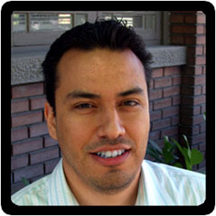
In The Weeds: Launched! A Crash Course in Lessons Learned
Ryan Elkins
Cofounder & CEO, Iactionable

Slide 7
Launched!
A Crash Course in Lessons Learned
Ryan Elkins – ryan@iactionable.com

Slide 8
Background
Dropped out of University of Oklahoma’s CS program
Did sales for a few years
Finished my CS degree at Neumont University
Worked as a developer for a few years
CEO of IActionable – Game Mechanics as a Service

Slide 9
Timeline

Slide 10
Lesson 1: Experiment

Slide 11
Lesson 2: Share
Nothing to lose, plenty to gain

Slide 12
Lesson 3: Plan
Set Dates
Be Accountable
Review Goals Weekly

Slide 13



Lesson 4: Network
It really is about who you know
Hacker News (news.ycombinator.com)
Blogs
Tiwtter /Facebook Groups
Wherever people in your space hang out

Slide 14








Lesson 5: Use Tools
They separate us from animals

Slide 15
LaunchUp #13 Supporters
Special thanks to LaunchUp Service Providers:

Slide 16



the BBQ Dude Mobile Food Truck
The BBQ Dude
@theBBQDude

Slide 17
Mobile food truck operation
Incredible BBQ made to order
Made fresh daily
Less Expensive than brick and mortar
restaurants
Ability to advertise for less through channels of Social Media
Different locations daily

Slide 18

ADVERTISING AND PROMOS
Social Media
Promos with 1280 the Zone
Big Budah
Recipe contests
Flash Mobs
Free Birthday promos
Anything different from “Normal”

Slide 19
National Trends
Food Trucks have grown in popularity
Food Network created reality show
Twitter account created just to follow and locate where trucks are serving food
Mobile apps for Truck locations

Slide 20
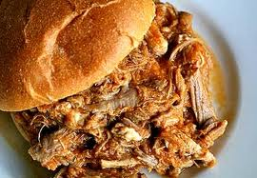
Menu Items
PULLED PORK SANDWICH - $5

Slide 21
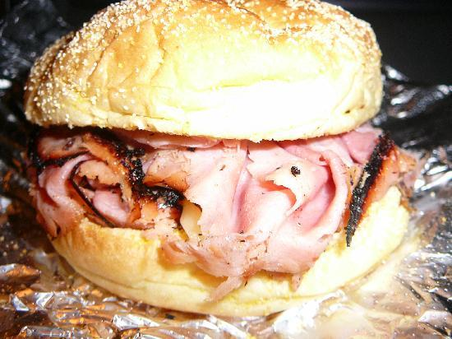
Smoked “Pit Ham” Sandwich $6

Slide 22
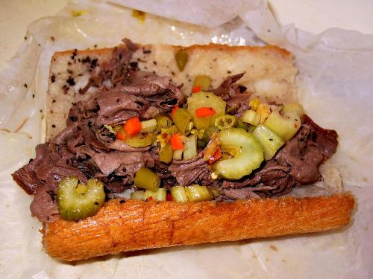
Sout’ Side Italian Beef $6

Slide 23
Also available
Sodas
Water
Specialty Drinks
Desserts
Side dishes

Slide 24
LaunchUp #13 Supporters
Special thanks to LaunchUp Service Providers:

Slide 25


The open platform for investment insight
Peter Skalla, CFA
Co-founder & CEO
pete@qbillion.com
December 2, 2010
Guy Harding
Co-founder & VP Engineering
guy@qbillion.com
Qbillion, Inc. 2010 Proprietary & Confidential

Slide 26


1. What is Qbillion
Online investment community in the direct context of financial data and analysis
Notes:
Look like an on-line financial analysis site . . . but strategy focused squarely on COMMUNITY . . . community based on financial data & analysis.

Slide 27
2. Problem w/ Finance on Web Today
40 million unique monthly visitors, but . . .
Data problem
Community structure problem

Slide 28
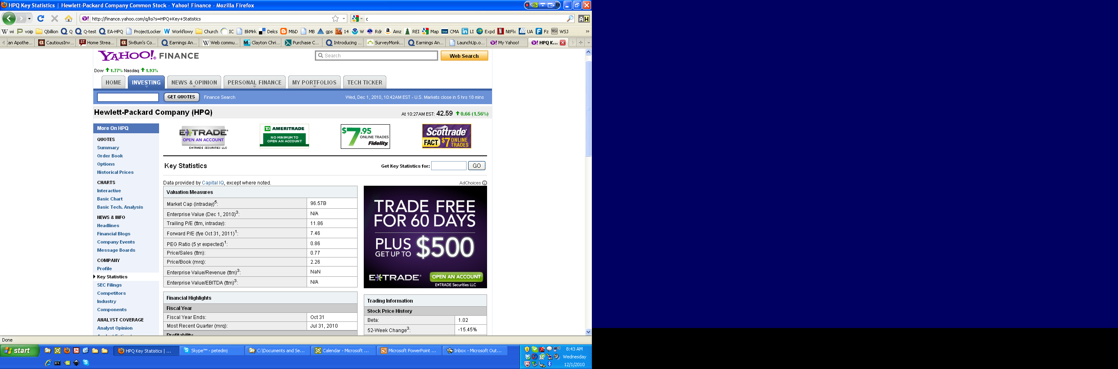

2. Problem w/ Finance on Web Today
HPQ down 1.7%, ObamaBirth Certificate missing

Slide 29
3. The Solution
Analysis / Insight
Tools
Community
Data
Ecosystem
Context
Notes:
Like trying to do science w/out peer-reviewed literature. Or on-line shopping w/out customer reviews.

Slide 30


Slide 31
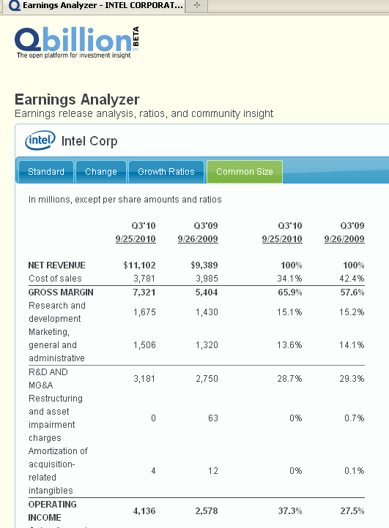
3. Earnings Analyzer User Feedback
“Simple--immediately intuitive”
“A great tool at analyzing”
“Straight forward and seems easy to use”
“It shows immediate utility and an obvious path for future functionality”
Notes:
Can quickly scale to 10,000 U.S. publicly traded companies.

Slide 32
4. Where we’re at
Developed 3 product features
Earnings Analyzer
Company Events & SEC Filing Finder
Earnings Analyzer . . . trial balloon
Initial in-network response testing
Public response testing
Tie to database (10,000 publicly traded companies)
Public Beta launch

Slide 33
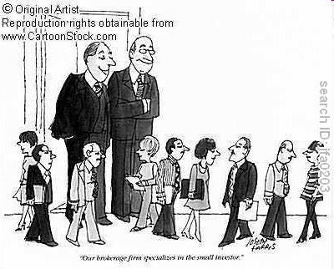
5. Target Audience & Revenue Model
Small to mid-size investors & Business professionals
Multi-million user potential
“Freemium” revenue model
Strong free content
Premium subscription--$10-$20 / mo. avg.
Notes:
Ad revenue: $4/user/year for non-paying users. Another $50 mil. in annual revenue.

Slide 34
6. Needs
Last 1/3rd of $100k seed round
Community building advice (features & outreach)
Site feedback (multidisciplinary)
Couple developers (entry level)
Django/Python
JavaScript/CSS/HTML
XBRL/XML
Thank you!
Notes:
Need people who share a portion of our passion

Slide 35
The End
[Note: following are reserve slides]

Slide 36
Co-founders
Peter Skalla, CFA
Co-founder & CEO
16 year finance professional
Sell-side analyst, investment manager, venture capital fund partner, CFO, and product manager
Wall Street Journal leading analyst in 1996, semiconductor industry
Guy Harding
Co-founder & VP of Engineering
Led i.TV development team
i.TV iPhone app has attracted over 3 million users.
Allstate, TenFold

Slide 37

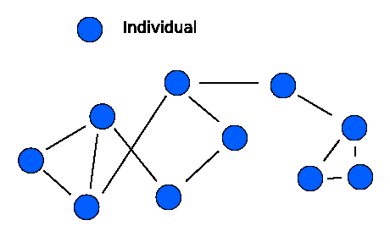



5. Technology convergence Why hasn't someone done this yet?
Crowdsourcing
Social networking
Open standards
Web 2.0
Cloud computing
HTML 5
Open source

Slide 38
LaunchUp #13 Supporters
Special thanks to LaunchUp Service Providers:

Slide 39



Slide 40


The Problem: Separated Families
Grandchild
Grandparent

Slide 41
Primary Market: Grandparents
56 MILLION
Grandparent households in the United States
The average age of new, grandparents is under 50.
69%
of baby boomers use the Internet at least once
per day—36% use it several times per day.
50%
of all grandparents live more than 200 miles
away from their grandchildren.

Slide 42

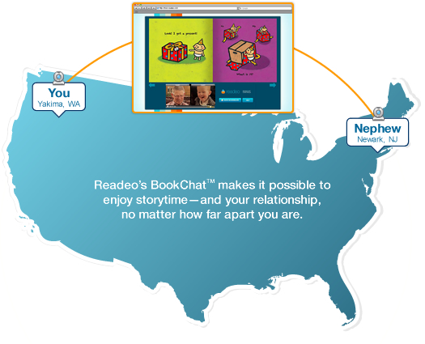
The Solution: Readeo

Slide 43
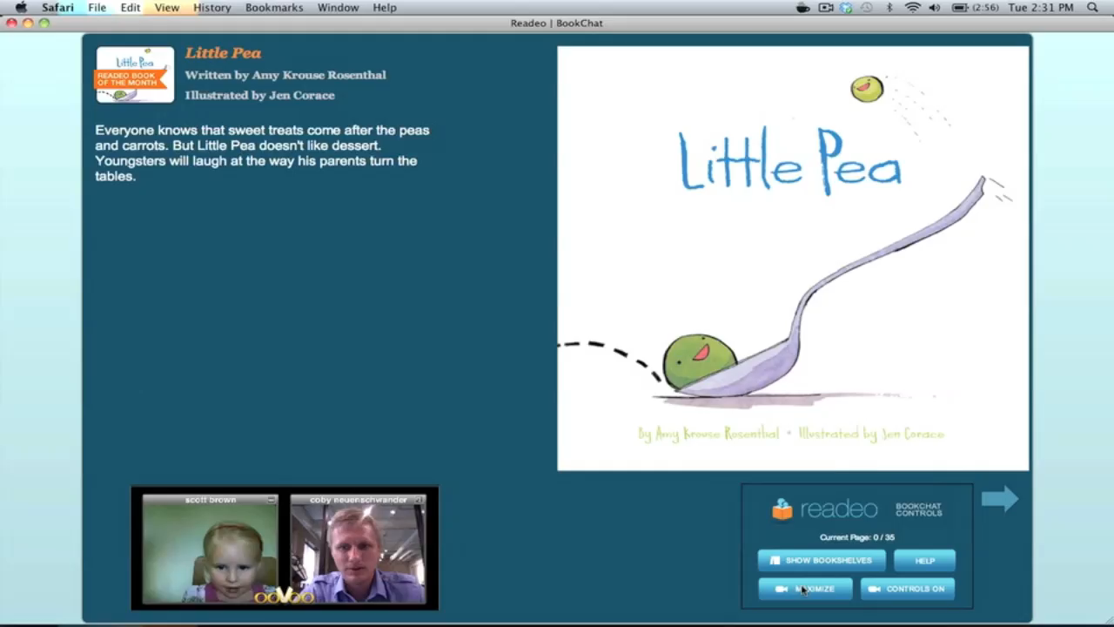
The Solution: Readeo

Slide 44



The Solution: Readeo

Slide 45






The Model: Subscription
Partners: Publishers
Over 100 children’s books and counting
Member
$9.99 / mo
or $99 / yr
Free Guest
Free Guest
Free Guest

Slide 46



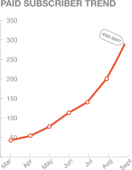
Progress: Where we are today
4000
Users
2,000
BookChats
12,000
Books Read
Press Coverage:

Slide 47


What Early Adopters Are Saying
“Thank you, thank you, thank you! Our grandson begs his mom everyday to call Grandma and Papa on Readeo! And, then he pays attention and wants one more book no matter how many we have already read!!!”
- Tere M., Grandma
“One more book!”
- Lily B.

Slide 48
Help?
Next Target Market
Of all the possible targets, who do we go after next?
Second Round of Funding
About to close
SEO
With a small budget & small team - what would you do?
Customer Service
As we take on more customers, we’re taking on more support requests, and again, that’s a drain on resources

Slide 49
LaunchUp #13 Supporters
Special thanks to LaunchUp Service Providers:

Slide 50
Announcements

Slide 51
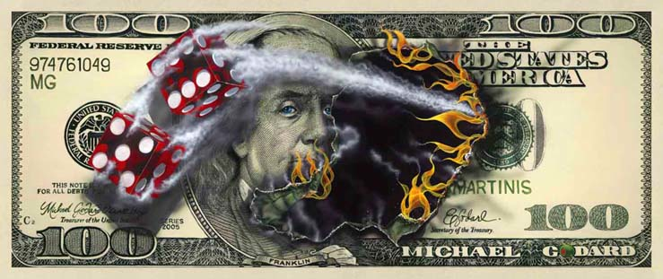
LaunchUp Companies
http://www.launchup.org/companies

Slide 52
LaunchUp #14:
6:30 p.m. Thursday January 6, 2011
One on One Marketing –
Thanksgiving Point
First Thursday = LaunchUp somewhere

Slide 53
LaunchUp #13 Supporters
Special thanks to LaunchUp Service Providers:

